Slide 1
Network Design & Training
with
Daniel L. Silver, PhD
I Gede Pasek Suta Wijaya
Copyright (c), 2014
All Rights Reserved

Slide 2
Network Design & Training Issues
Design:
Architecture of network
Structure of artificial neurons
Learning rules
Training:
Ensuring optimum training
Learning parameters
Data preparation
and more ....

Slide 3
Network Design

Slide 4
Network Design
Architecture of the network: How many nodes?
Determines number of network weights
How many layers?
How many nodes per layer?
Input Layer Hidden Layer Output Layer
Automated methods:
augmentation (cascade correlation)
weight pruning and elimination

Slide 5
Network Design
Architecture of the network: Connectivity?
Concept of model or hypothesis space
Constraining the number of hypotheses:
selective connectivity
shared weights
recursive connections
Notes:
Show 2 OHs of character recognition networks (from Hinton’s notes)

Slide 6
Network Design
Structure of artificial neuron nodes
Choice of input integration:
summed, squared and summed
multiplied
Choice of activation (transfer) function:
sigmoid (logistic)
hyperbolic tangent
Guassian
linear
soft-max

Slide 7
Network Design
Selecting a Learning Rule
Generalized delta rule (steepest descent)
Momentum descent
Advanced weight space search techniques
Global Error function can also vary
- normal - quadratic - cubic

Slide 8
Network Training

Slide 9
Network Training
How do you ensure that a network has been well trained?
Objective: To achieve good generalization
accuracy on new examples/cases
Establish a maximum acceptable error rate
Train the network using a validation test set to tune it
Validate the trained network against a separate test set which is usually referred to as a production test set

Slide 10
Network Training
Approach #1: Large Sample
When the amount of available data is large ...
Available Examples
70%
Divide randomly
30%
Training
Set
Production
Set
Generalization error
= test error
Test
Set
Compute
Test error
Used to develop one ANN model

Slide 11
Network Training
Approach #2: Cross-validation
When the amount of available data is small ...
Available Examples
Repeat 10
times
90%
10%
Test
Set
Generalization error
determined by mean
test error and stddev
Training
Set
Pro.
Set
Used to develop 10 different ANN models
Accumulate
test errors

Slide 12
Network Training
How do you select between two ANN designs ?
A statistical test of hypothesis is required to ensure that a significant difference exists between the error rates of two ANN models
If Large Sample method has been used then apply McNemar’s test*
If Cross-validation then use a paired t test for difference of two proportions
*We assume a classification problem, if this is function
approximation then use paired t test for difference of means

Slide 13
Network Training
Mastering ANN Parameters
Typical Range
learning rate - 0.1 0.01 - 0.99
momentum - 0.8 0.1 - 0.9
weight-cost - 0.1 0.001 - 0.5
Fine tuning : - adjust individual parameters at each node and/or connection weight
automatic adjustment during training

Slide 14
Network Training
Network weight initialization
Random initial values +/- some range
Smaller weight values for nodes with many incoming connections
Rule of thumb: initial weight range should be approximately
coming into a node

Slide 15
Network Training
Typical Problems During Training
E
Steady, rapid decline
in total error
Would like:
# iter
E
Seldom a local minimum - reduce learning or momentum parameter
But
sometimes:
# iter
E
Reduce learning parms.
- may indicate data is not learnable
# iter

Slide 16
Training Algorithm
Unsupervised : learning without guideline
Implemented for grouping the similar input (clustering)
Supervised learning: learning with guideline (usually target)
When the output/target is known
By learning the ANN weight is adjusted by given input to achieve the given target
Implemented for classification/forecasting, etc

Slide 17
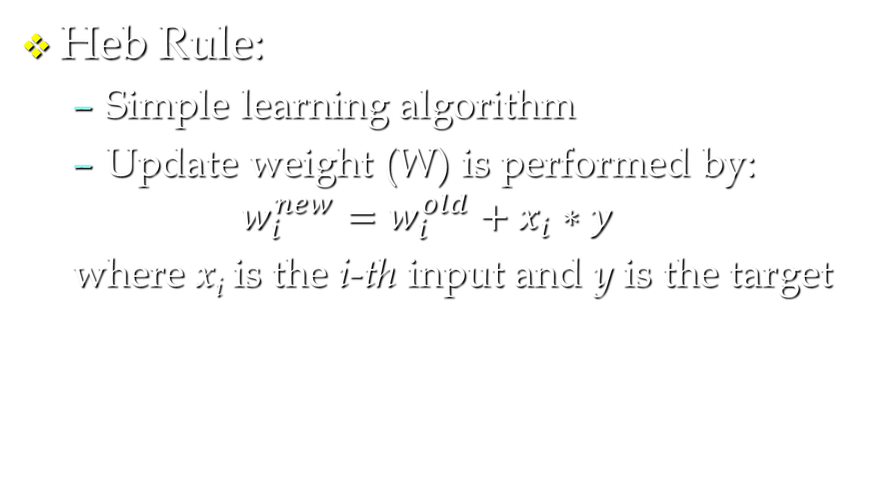
Supervised learning
Heb Rule:
Simple learning algorithm
Update weight (W) is performed by:
$$w_{i}^{new}=w_{i}^{old}+x_{i}∗y$$
where x_{i} is the i-th input and y is the target

Slide 18
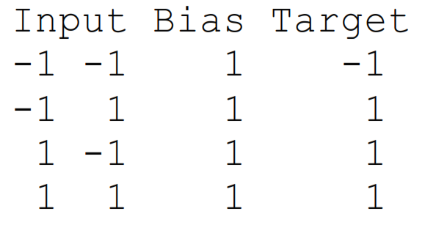
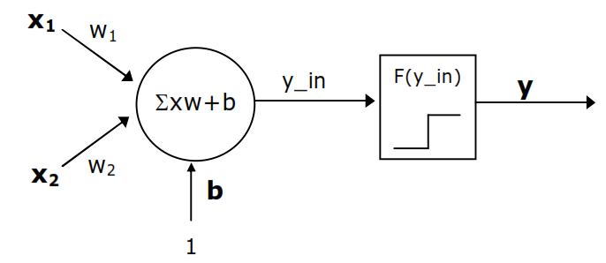
Example
Given the data:
Performed the learning using Heb rule for NN:

Slide 19
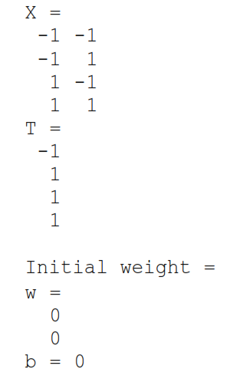
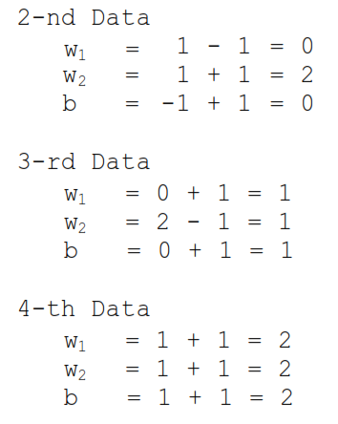
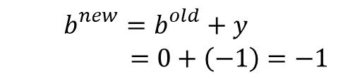
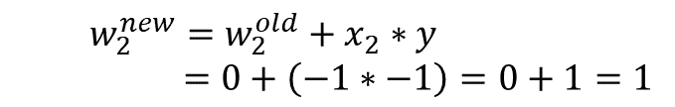

Learning Step
Update weight:
1-st data:
$$w_{1}^{new}=w_{1}^{old}+x_{1}∗y$$
$=0+\left(−1∗−1\right)=0+1=1$
$$w_{2}^{new}=w_{2}^{old}+x_{2}∗y$$
$=0+\left(−1∗−1\right)=0+1=1$
$$b_{}^{new}=b_{}^{old}+y$$
$=0+\left(−1\right)=−1$

Slide 20
Learning Step
Final weight: w₁=2, w₂=2, and b=2
Testing for input x=[-1 1]:
y_{in}=2*-1+2*1+2=2
y=f(y_{in})=1 for bipolar step function
Testing for input x=[-1 -1]:
y_{in}=2*-1+2*-1+2=-2
y=f(y_{in})=-1 for bipolar step function
The learning could achieve the target

Slide 21
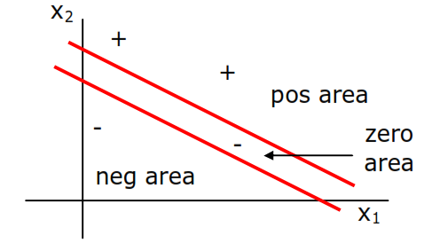


Perceptron
Simple ANN for binary classification
The learning is defined the weight which is able to achieve the following classification line
Pos line:
Neg line:
Where θ is non negative

Slide 22
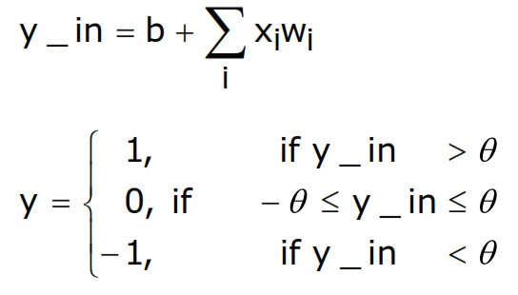
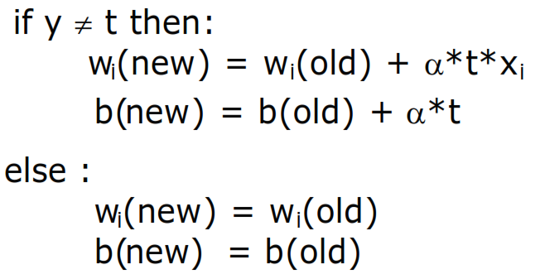
Learning algorithm
Initialize all weights, biases, and set learning rate, α, (0< α <1)
For each pair of s-t, do:
Calculate response:
Update weights and biases
Until weight not change

Slide 23
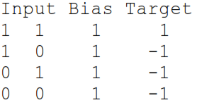
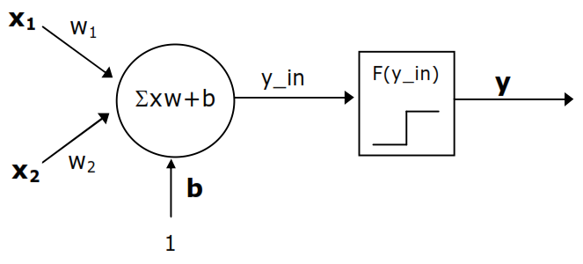
Example
Give the data pattern and target:
Perform the learning of the following ANN:

Slide 24
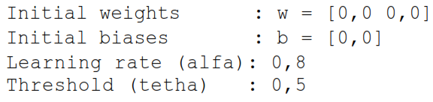
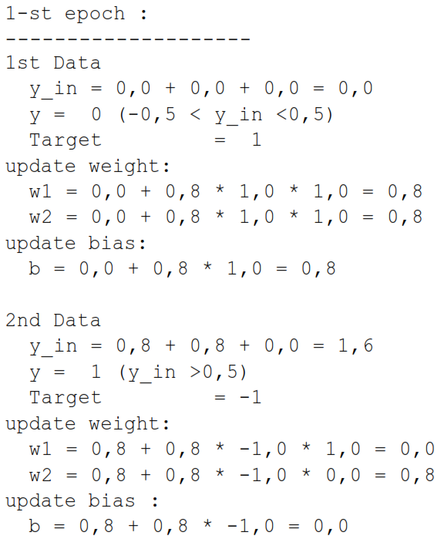
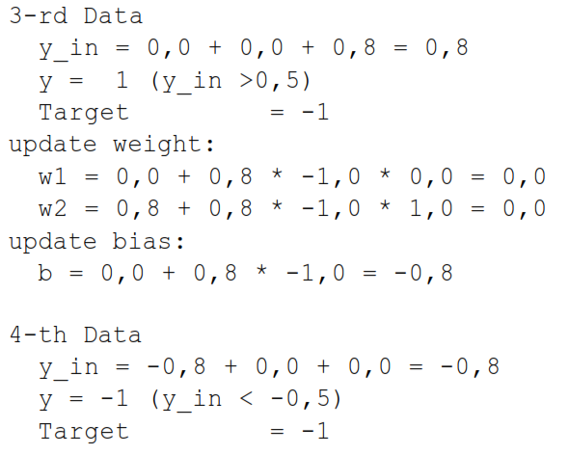
Initialize data:
Do learning :
Why no update in
4th-data?

Slide 25


Repeat until no weight is changed
Finally the best w and b are: w₁=1.6, w₂=2.4, and b=-3,2
Classification line:
Pos line:
Neg line:
What is epoch?
What is terminate criteria?

Slide 26

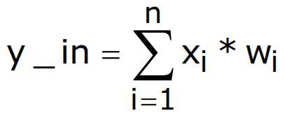

Delta rule
Update the weight based on delta:
where
Update weight:

Slide 27
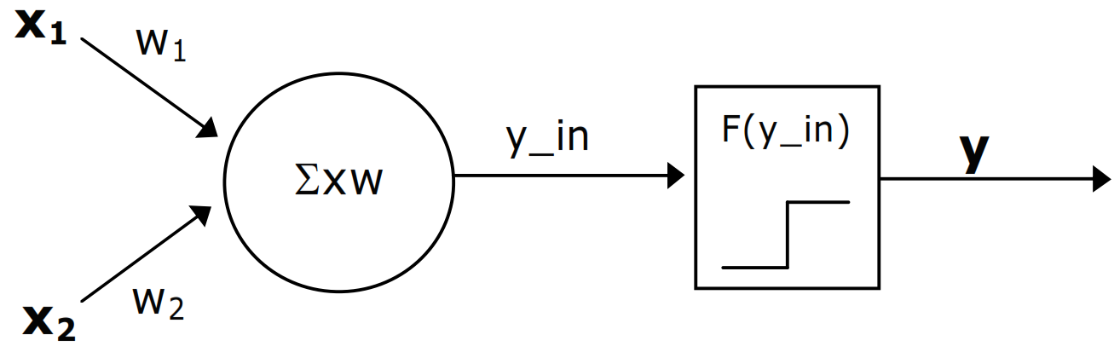
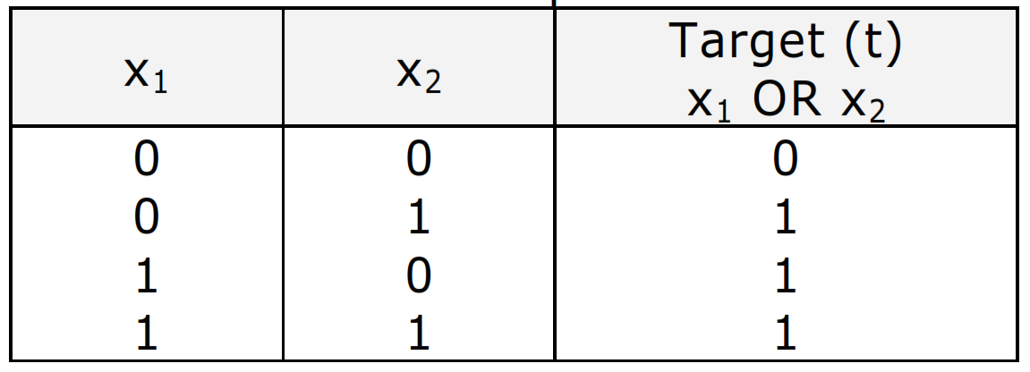
example
Given simpel ANN:
Training it to fit the following problem

Slide 28
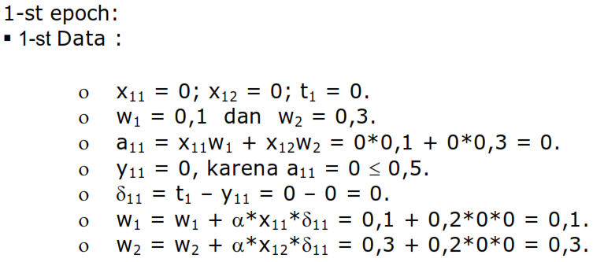
Initialize data:
AF: stef fuction, theta=0,5
W=[0,1 0,3] random
Learning rate =0,2
Do learning

Slide 29
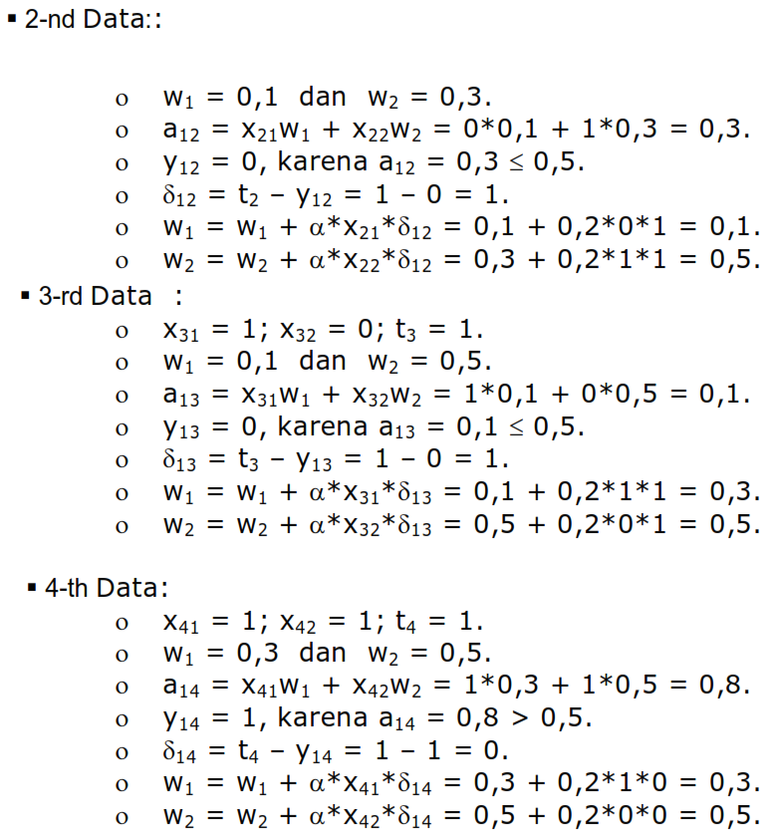

Slide 30
Repeat until error (t-y)=0
Finally the best w and b are: w₁=0.7, w₂=0.7
Classification :
x₁ | x₂ | w₁ | w₂ | y_{in} | y | t | error
0 | 0 | 0.7 | 0.7 | 0 | 0 | 0 | 0
0 | 1 | 0.7 | 0.7 | 0.7 | 1 | 1 | 0
1 | 0 | 0.7 | 0.7 | 0.7 | 1 | 1 | 0
1 | 1 | 0.7 | 0.7 | 1.4 | 1 | 1 | 0
What is epoch?
What is terminate criteria?

Slide 31
Other learning algorithm
Back Propagation
Heteroassociative Memory
Bidirectional Associative Memor y (BAM)
Learning Vector Quantization (LVQ)

Slide 32
Data Preparation

Slide 33
Data Preparation
Garbage in Garbage out
The quality of results relates directly to quality of the data
50%-70% of ANN development time will be spent on data preparation
The three steps of data preparation:
Consolidation and Cleaning
Selection and Preprocessing
Transformation and Encoding

Slide 34
Data Preparation
Data Types and ANNs
Four basic data types:
nominal discrete symbolic (blue,red,green)
ordinal discrete ranking (1st, 2nd, 3rd)
interval measurable numeric (-5, 3, 24)
continuous numeric (0.23, -45.2, 500.43)
bp ANNs accept only continuous numeric values (typically 0 - 1 range)

Slide 35
Data Preparation
Consolidation and Cleaning
Determine appropriate input attributes
Consolidate data into working database
Eliminate or estimate missing values
Remove outliers (obvious exceptions)
Determine prior probabilities of categories and deal with volume bias

Slide 36
Data Preparation
Selection and Preprocessing
Select examples random sampling
Consider number of training examples?
Reduce attribute dimensionality
remove redundant and/or correlating attributes
combine attributes (sum, multiply, difference)
Reduce attribute value ranges
group symbolic discrete values
quantize continuous numeric values

Slide 37
Data Preparation
Transformation and Encoding
Nominal or Ordinal values
Transform to discrete numeric values
Encode the value 4 as follows:
one-of-N code (0 1 0 0 0) - five inputs
thermometer code ( 1 1 1 1 0) - five inputs
real value (0.4)* - one input if ordinal
Consider relationship between values
(single, married, divorce) vs. (youth, adult, senior)
* Target values should be 0.1 - 0.9 , not 0.0 - 1.0 range

Slide 38
Data Preparation
Transformation and Encoding
Interval or continuous numeric values
De-correlate example attributes via normalization of values:
Euclidean: n = x/sqrt(sum of all x^2)
Percentage: n = x/(sum of all x)
Variance based: n = (x - (mean of all x))/variance
Scale values using a linear transform if data is uniformly distributed or use non-linear (log, power) if skewed distribution

Slide 39
Data Preparation
Transformation and Encoding
Interval or continuous numeric values
Encode the value 1.6 as:
Single real-valued number (0.16)* - OK!
Bits of a binary number (010000) - BAD!
one-of-N quantized intervals (0 1 0 0 0)
- NOT GREAT! - discontinuities
distributed (fuzzy) overlapping intervals
( 0.3 0.8 0.1 0.0 0.0) - BEST!
* Target values should be 0.1 - 0.9 , not 0.0 - 1.0 range

Slide 40
TUTORIAL #5
Develop and train a BP network on real-world data
Also see slides covering Mitchell’s Face Recognition example

Slide 41
Post-Training Analysis

Slide 42
Post-Training Analysis
Examining the neural net model:
Visualizing the constructed model
Detailed network analysis
Sensitivity analysis of input attributes:
Analytical techniques
Attribute elimination

Slide 43
Post-Training Analysis
Visualizing the Constructed Model
Graphical tools can be used to display output response as selected input variables are changed
Response
Temp
Size

Slide 44
Post-Training Analysis
Detailed network analysis
Hidden nodes form internal representation
Manual analysis of weight values often difficult - graphics very helpful
Conversion to equation, executable code
Automated ANN to symbolic logic conversion is a hot area of research

Slide 45
Post-Training Analysis
Sensitivity analysis of input attributes
Analytical techniques
factor analysis
network weight analysis
Feature (attribute) elimination
forward feature elimination
backward feature elimination

Slide 46
The ANN Application Development Process
Guidelines for using neural networks
1. Try the best existing method first
2. Get a big training set
3. Try a net without hidden units
4. Use a sensible coding for input variables
5. Consider methods of constraining network
6. Use a test set to prevent over-training
7. Determine confidence in generalization through cross-validation

Slide 47
Example Applications
Pattern Recognition (reading zip codes)
Signal Filtering (reduction of radio noise)
Data Segmentation (detection of seismic onsets)
Data Compression (TV image transmission)
Database Mining (marketing, finance analysis)
Adaptive Control (vehicle guidance)

Slide 48
THE END Thanks for your participation!

